Slide 1
Prime time
黃宥翔 chris900623@gmail.com
郭昱 ivan010517@gmail.com

Slide 2
OUTLINE
01
Analysis format
02
Manual

Slide 3
Analysis format
Power Analysis Flow - Primetime PX

Slide 4
Analysis format
Simulation Activity Formats
SAIF (Switching Activity Interchange Format)
T0 - duration of time found in logic 0 state.
T1 - duration of time found in logic 1 state.
TX - duration of time found in unknown “X” state
TC - sum of the rise (0-to-1) and fall (1-to-0) transitions that are captured during monitoring
IG - number of 0 - X - 0 and 1 - X - 1 glitches captured during monitoring
RISE - Rise transitions in a given state.
FALL - Fall transitions in a given state.
Toggle Rate (Tr) = TC / duration
Glitch Rate (Gr) = derate_glitch * IG
derate_glitch 0.5 (default)
Wave file
VCD (Value Change Dump) → Prime time
FSDB(Fast Signal Data Base) → Verdi

Slide 5
Analysis format
Average Power Analysis
Average Power analysis applications
Packaging selection
The switching activity consists of toggle rates and static probabilities in average power analysis
Toggle Rate (Tr) for dynamic power
P(switching) = 0.5 * Cload * vdd² * Tr
P(internal) = Energy_{int} * Tr
power_default_toggle_rate 0.1 (default)
Static Probability (Sp) for leakage power
Probability of logic 1 for a node
P(leak) = (Pleak0 * 1-Sp) + (Pleak1 * Sp)
power_default_static_probability 0.5 (default)
Default toggle will be applied to the propagation starting point
primary inputs
black box outputs

Slide 6
Analysis format
Time-Based Power Analysis
Peak Power analysis application
IR drop analysis
Peak power analysis types
Cycle accurate Peak power analysis
Event based Peak power analysis

Slide 7
manual
Primetime manual
Design Compiler
Needed:
PE.v
Dump:
PE_gate.v
PE_syn.sdc
PE_syn.sdf
PE_syn.ddc
Post simulation
Needed:
PE_gate.v
testbenth.v PE_syn.sdf
N16ADFP_StdCell.v
Dump:
PE_wave.vcd
Primetime
Needed:
PE_gate.v
PE_syn.sdc
PE_syn.sdf
PE_wave.vcd
Dump:
Report_power_average_vcd.rpt

Slide 8

manual
Design Compiler
Please have a look at the Design Compiler.pptx
verilog (gate level netlist)
ddc (save your design)
sdc (Synopsys Design Constraints)
sdf (Standard Delay Format)

Slide 9
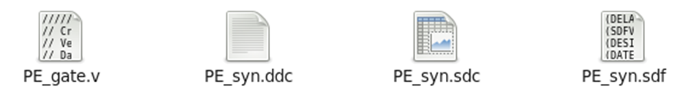

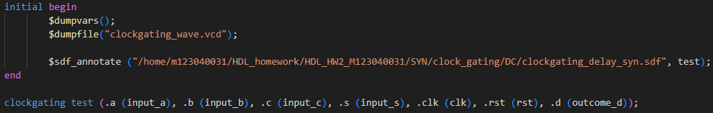
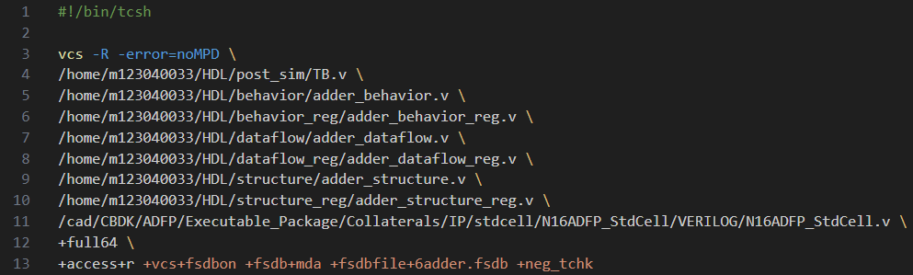
manual
Post-synthesis simulation method 1
Testbenth
Use vcs to dump the file
1. tcsh
2. source post_sim.sh
testbench
Gate Level Netlist
Standard Cell
Output Waveform
建議使用絕對路徑

Slide 10



manual
Primetime
verilog (gate level netlist)
sdc (Synopsys Design Constraints)
sdf (Standard Delay Format)
vcd(wave file)
Use Primetime
pt_shell -f pt.tcl

Slide 11
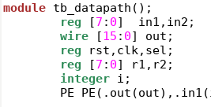
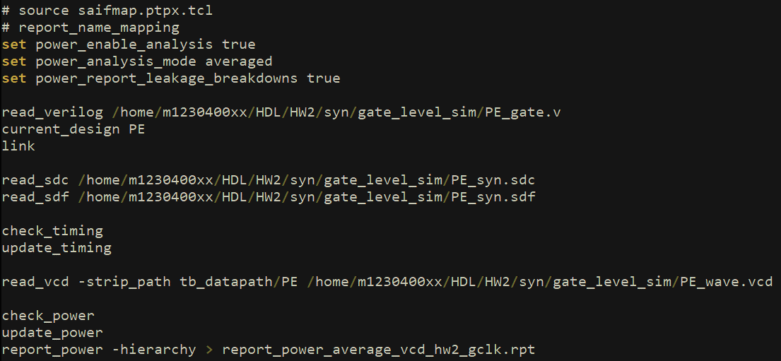
manual
pt.tcl
gate level netlist
Your design module name
Testbench module name/ Your design instance name
*此圖只是對應ppt的操作範例，檔案路徑及名稱請根據自己命名與路徑或作業要求進行修改。

Slide 12
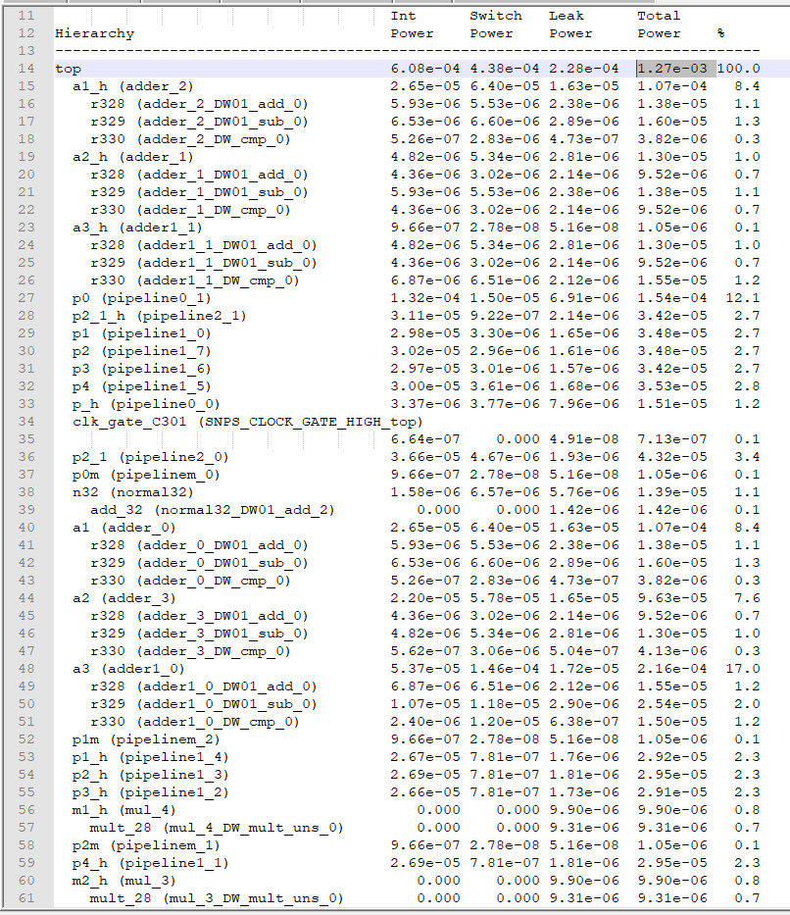
manual
Power average
(此範例與HW2不同)

Slide 13
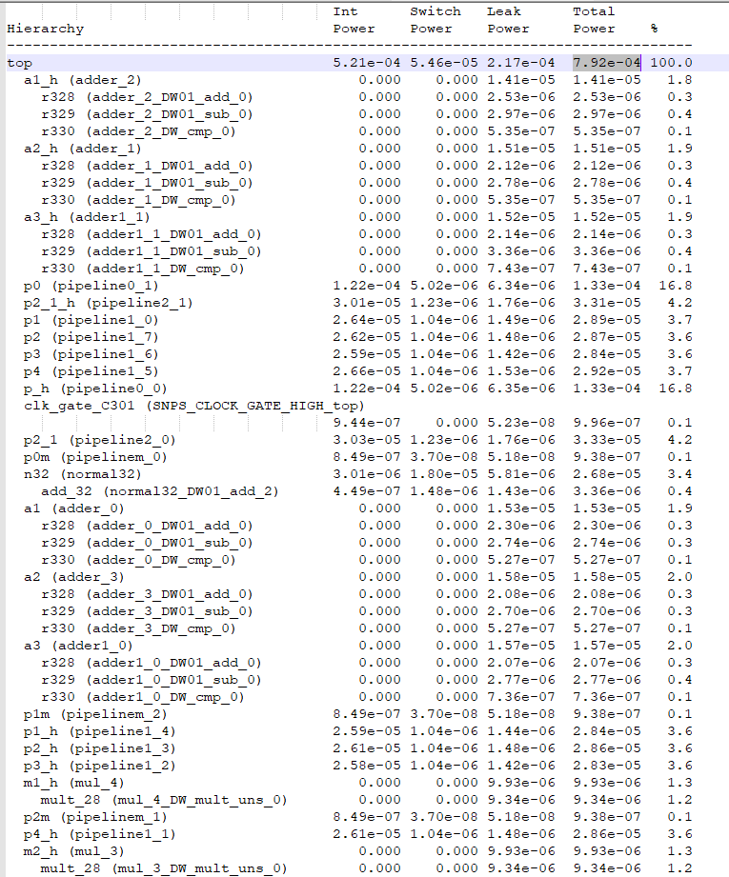
manual
Power average
with clock-gating
(此範例與HW2不同)
Total Power下降

Slide 14
Thank
you

